Slide 1



Slide 2

Online Smart Cheff Services
Supervised by:
Miss. Anum Zahra
Group Members:
Attique ur rehman ( FA17-BCS-025 )
Muqadas umar ( FA17-BCS-019 )
Presented on
(Cs Department) COMSATS University Islamabad
Attock Campus

Slide 3
Outline
Introduction
Problem statement
Objectives
Methodology
Functional requirements
Tools and technology
Benefits
Diagrams
System screenshots
References

Slide 4
Introduction
The "Online Smart Chef Services“ simplifies the ordering process for both the chef and the customer .It allows customer to easily order any menu at any event.
This allows chefs to rapidly experience the orders as they are received and process all orders effectively with minimal delays.
The recommendation systems for chef wise, customer wise and the area wise is introduced i-e Recommendation of chef and dishes to users and other chefs based upon reviews and location with easy profile management and communication between the chefs and the customers

Slide 5
Problem Statement
For putting in any requests clients need to visit hotels or restaurants to think about food things and at that point place request and pay. In this strategy a lot of time and manual work is required. How to overcome this?
While putting in a request via telephone, client comes up short on the actual duplicate of the menu item, absence of visual affirmation that the request was put accurately.
Provides a feedback system in which user can rate the food items.

Slide 6
Objectives
The main aims and objectives of our system are as under :
Provide an online android based freelancing platform to the chefs.
To build up a application that satisfy the customer and managed a large number of orders without wasting time.
To introduce location based recommendations using machine learning Algorithms
To rate the chef performance with the help of feedbacks and reviews.

Slide 7
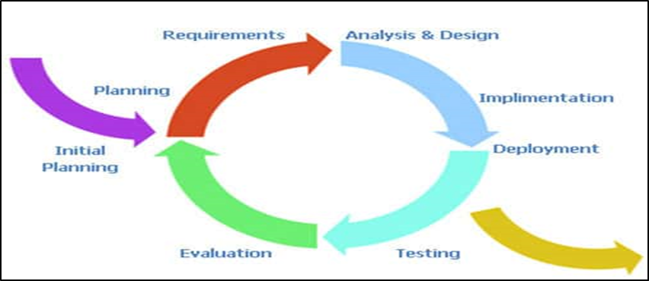
Methodology
Admin panel design
Chef panel design
User experience design
UML design
Database design
Evaluation and testing

Slide 8
Functional requirements
Admin login
Add Chefs
Remove Chefs.
View Profiles
Chef login
Upload profile and work.
Recommended chefs depending upon location
Take orders
Check reviews
customer login
Recommended chefs and dishes depending upon location
Find chefs and place order
Give reviews
Add to cart

Slide 9
Tools and Technologies
Tools & Technologies | Rationale
Java and python | Programming language
MS word | Documentation work
MS PowerPoint | Presentation work
UML | Diagram work
Android Studio | Programing tool
Firebase Real Time Database | Backend work

Slide 10
Benefits
Provides android based freelancing platform for Cheffs.
Location based recommendations and offers.
Better services and communication.
To leave a review and feedback in case of any issue.
Less time-consumption for customers.

Slide 11
Diagrams
Use Case Diagrams
Admin Use Case Diagram
Chef Use Case Diagram
Customer Use Case Diagram
Activity Diagrams
Admin Activity Diagram
Chef Activity Diagram
Customer Activity Diagram
Class Diagram
Sequence Diagram

Slide 12
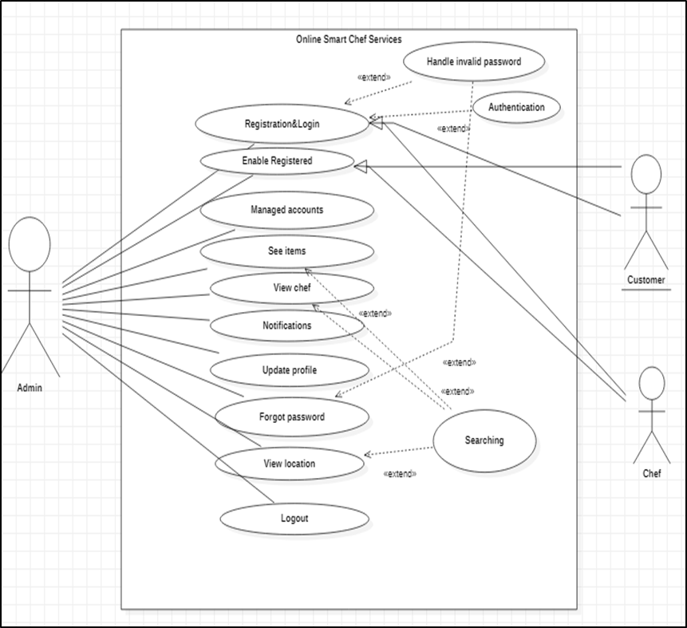
Admin Use case Diagram

Slide 13
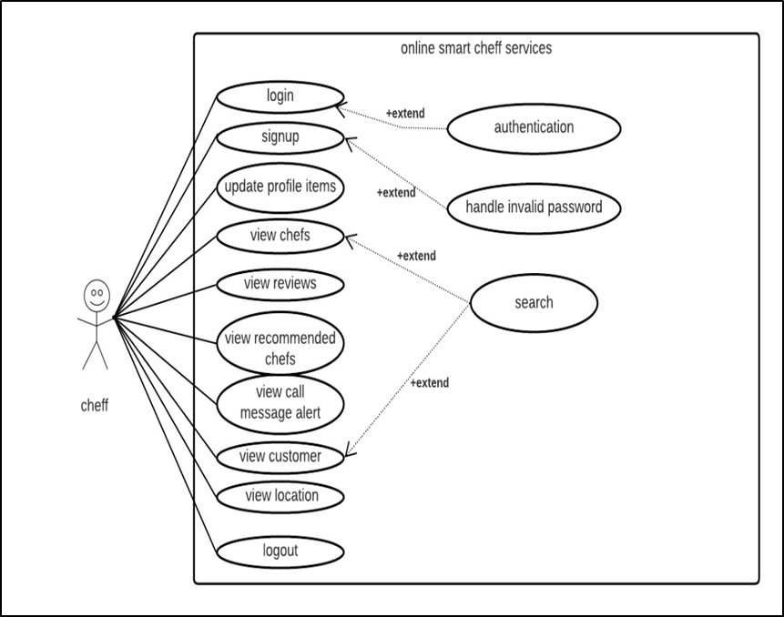
Chef Use case Diagram

Slide 14
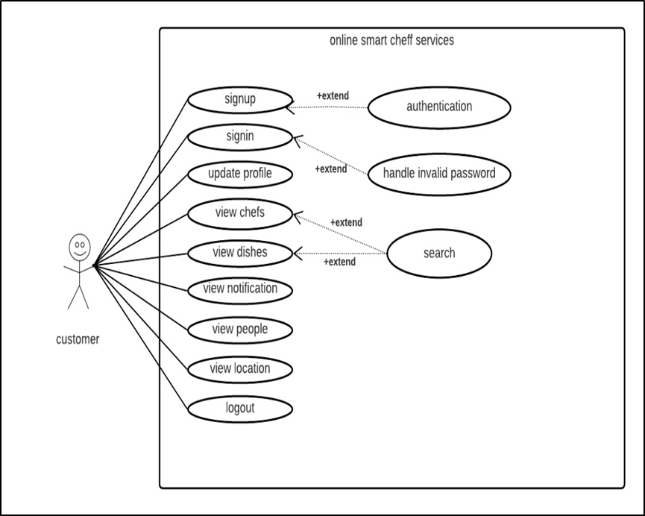
Customer Use case Diagram

Slide 15
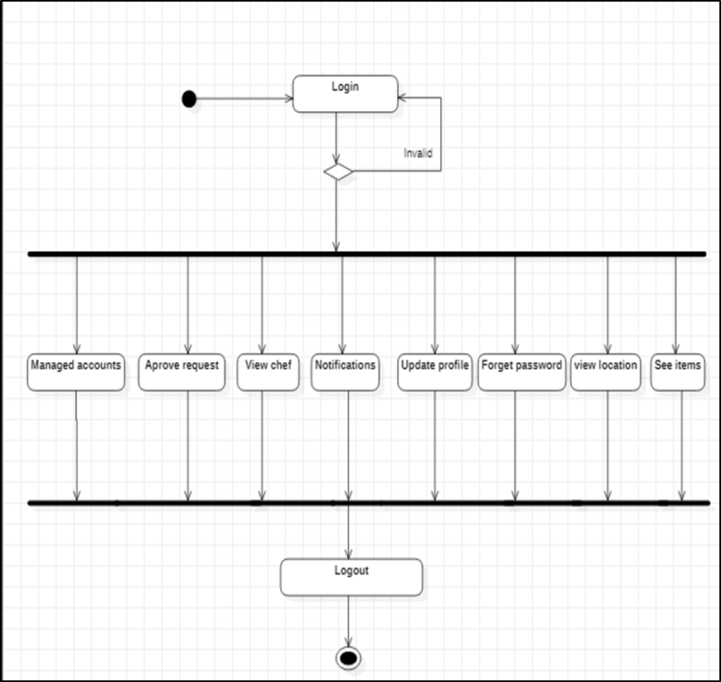
Admin Activity Diagram

Slide 16
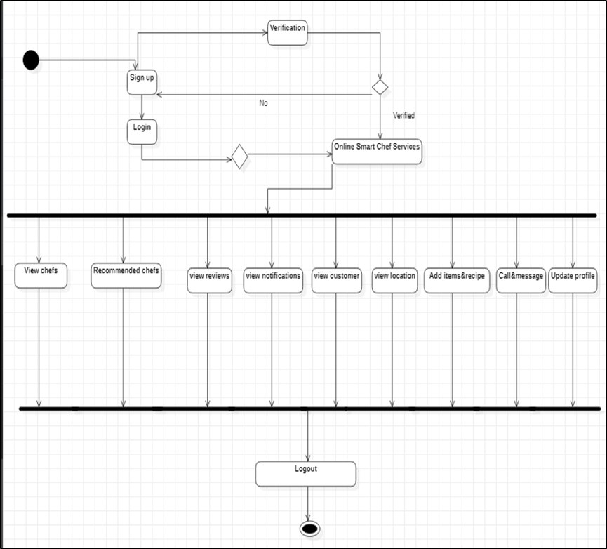
Chef Activity Diagram

Slide 17
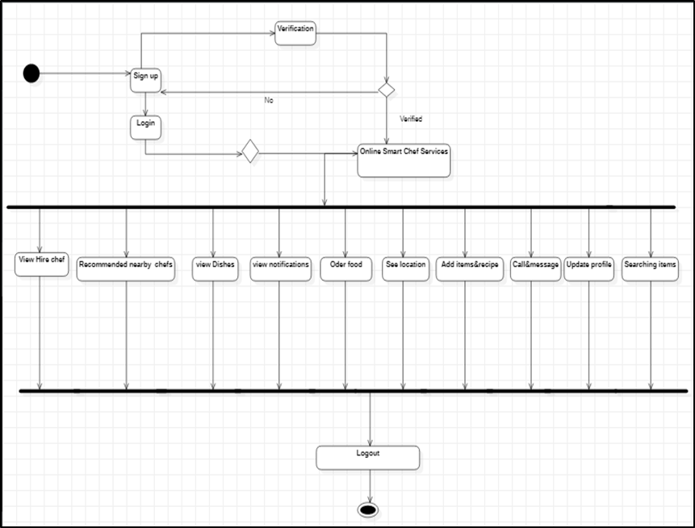
Customer Activity Diagram

Slide 18
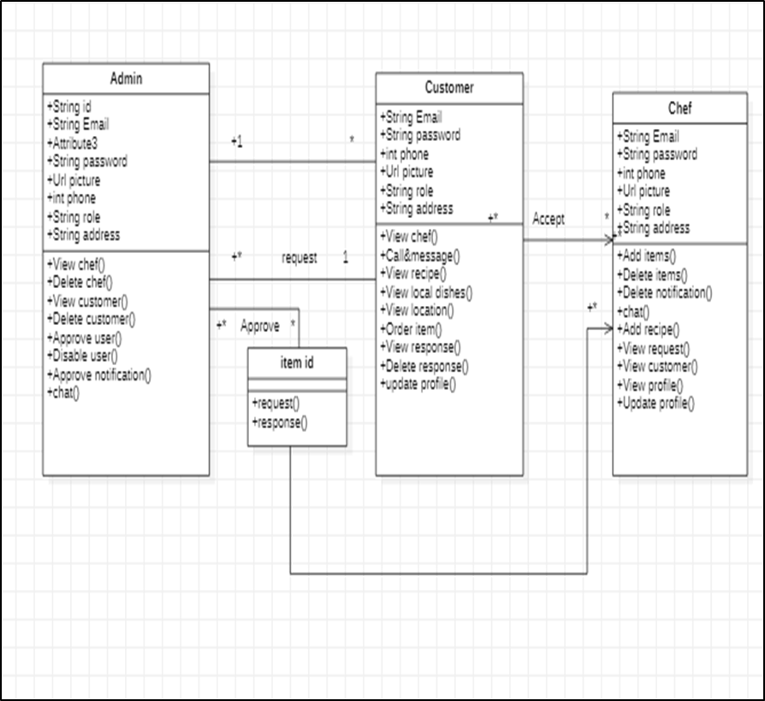
Class Diagram

Slide 19
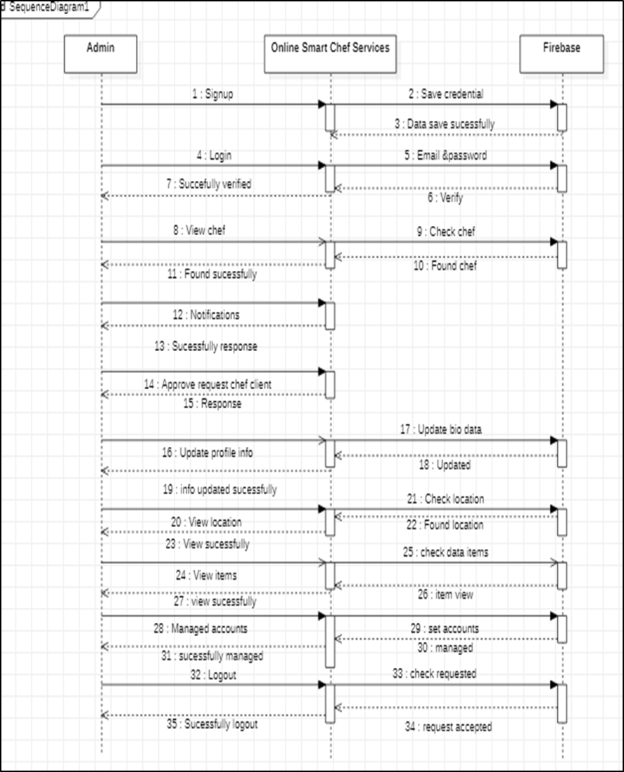
Admin Sequence Diagram

Slide 20
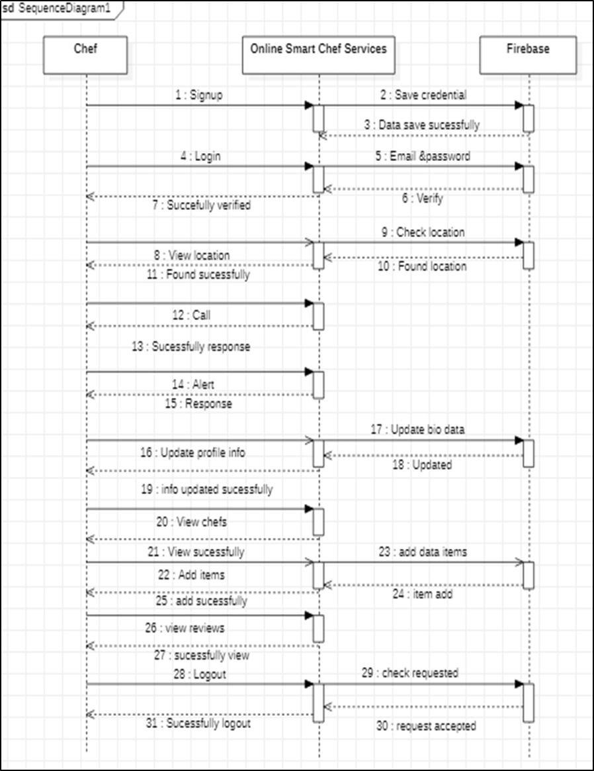
Chef Sequence Diagram

Slide 21
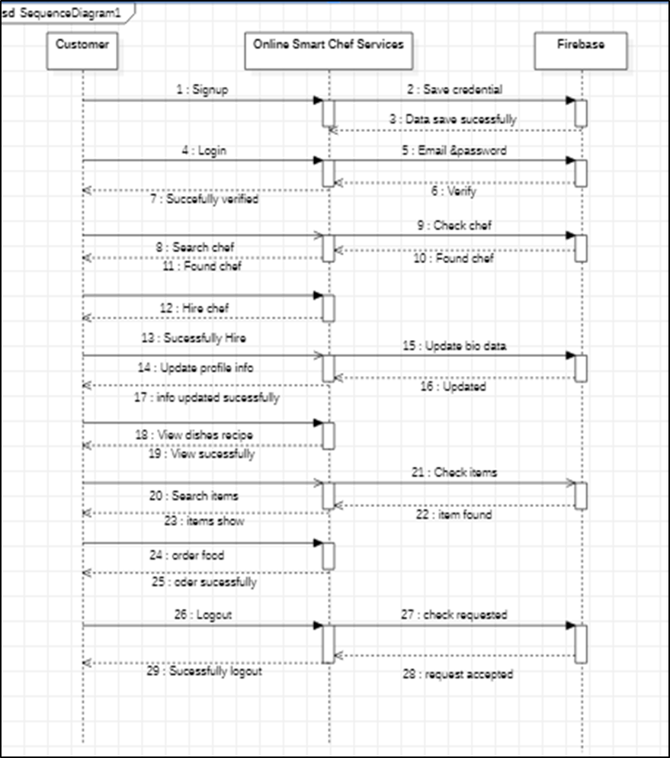
Customer Sequence Diagram

Slide 22
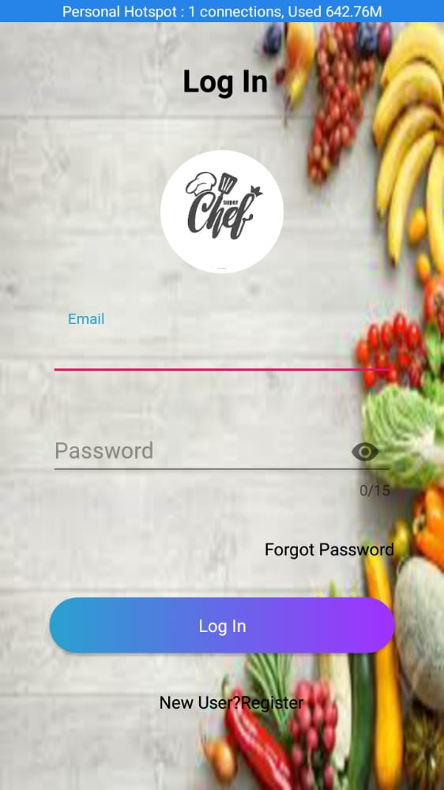
Login

Slide 23
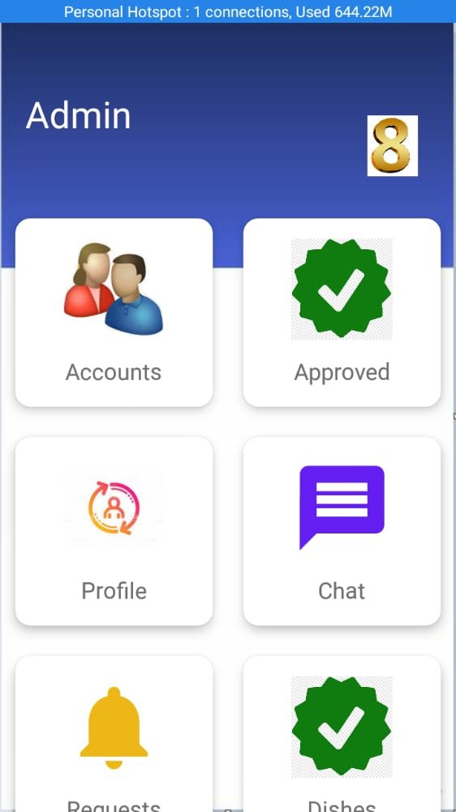
Admin

Slide 24
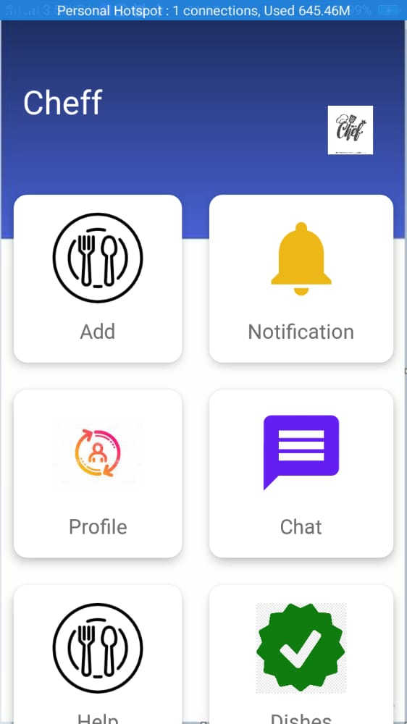
Chef

Slide 25
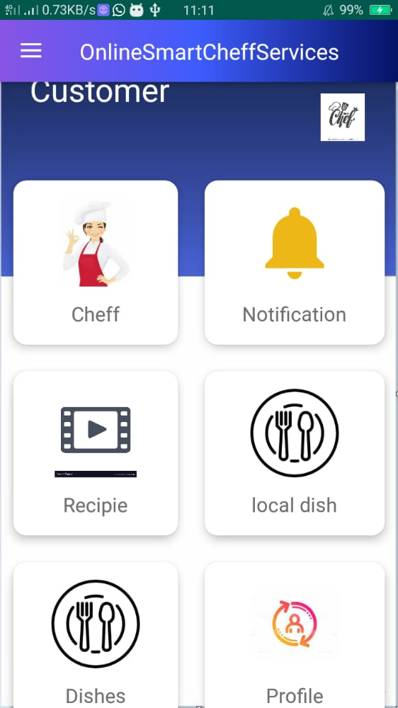
Customer

Slide 26
References
1. Location Based Services using Android Mobile Operating System by Amit Kushwaha, Vineet Kushwaha from Department of Electronics & Communication Engineering IIMT Engineering College, Meerut-250001, India. International Journal of Advances in Engineering & Technology, Mar 2011. IJAET ISSN: 2231-1963
2. Location Based Tracking Application Using Android Mobile Operating System by Apoorva Vengurlekar, Kiran Shukla, Dnyaneshwar J. Dhangar from Rajiv Gandhi Institute of Technology, Mumbai. International Journal of Scientific & Engineering Research, Volume 5, Issue 3, March-2014 821 ISSN 2229-5518.
3. Automated Food Ordering System with Interactive User Interface Approach by YoungChai Tan, KienLoong Lee, ZhiChao Khor, KaeVin Goh, KhimLengTan, BentFie Lew from Department of Engineering and Science University Tunku Abdul Rahman (UTAR),
4. Whitten, Jeffrey L. and Lonnie D. Bentley. (2007). System Analysis and Design Methods. (6th edition).New York: McGraw-Hill Irwin.
5. Yadav, Manish. (2011). History of Android. Retrieved on 10-11-2012 from http://www.tech2crack.com/history-android/

Slide 27


